Slide 1
CHILDHOOD SOLID TUMORs
From anesthesia point of view

Slide 2
Cancer Types by Age Group
Tumor Type | Ages 0-14 | Ages 15-19
Leukemia | 28% | 10%
CNS | 22% | 10%
Neuroblastoma | 8% | 0.2%
NHL | 6% | 8%
Hodgkin’s | 3.6% | 16.8%
Wilm’s tumor | 6% | 0.3%
Rhabdomyosarcoma | 3.6% | 1.7%
NRSTS | 3.5% | 5.1%
Osteosarcoma | 2.6% | 4.2%
Ewing sarcoma | 1.5% | 2.4%
Germ cell/gonadal | 3.5% | 12.4%
Retinoblastoma | 3.2% | 0%
Hepatoblastoma | 1.3% | 0%
Thyroid | 1.1% | 7.3%
Melanoma | 1.1% | 7.6%

Slide 3
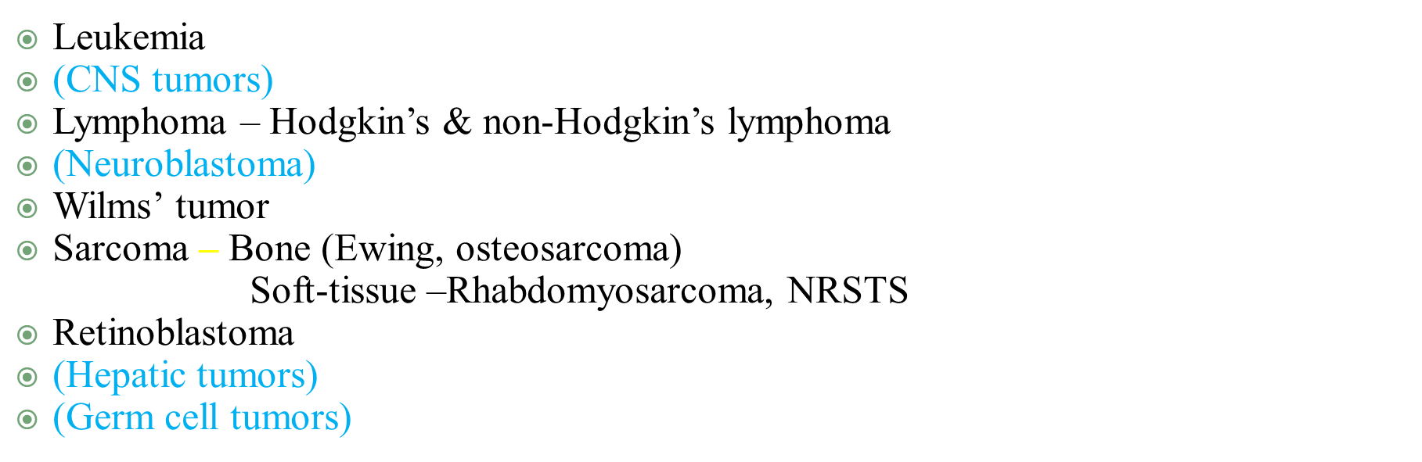
Major Cancer Types in Children

Slide 4
Mesenchymal tumors
Tumors of bone (Osteosarcoma, Ewing sarcoma)
Tumors of soft tissues (Soft tissue sarcomas=STS)
Tumors of skeletal muscle (Rhabdomyosarcoma)
Tumors of smooth muscle (Leiomyosarcoma)
Tumors of adipose tissue (Liposarcoma)
Tumors of fibroblasts (Fibrosarcoma)
Tumors of cartilage (Chondrosarcoma, synovial sarcoma)
Tumors of blood vessels (Angiosarcoma)
MPNST, clear cell sarcoma, inflammatory myofibroblastic tumor, desmoid (fibromatosis), DSRCT, MFH

Slide 5
Pediatric soft tissue sarcomas
The most common form of soft-tissue sarcoma in childhood is rhabdomyosarcoma (50% of all STS)
For convenience – all other soft-tissue sarcomas of childhood are called non-rhabdo soft tissue sarcomas (NRSTS) – and account for the remaining 50% of STS

Slide 6
Rhabdomyosarcoma
A tumor which arises from immature mesenchymal cells committed to skeletal muscle lineage
RMS can arise in multiple organs giving rise to a wide spectrum of clinical presentations
Some of these organs (e.g. – bladder) do not normally contain skeletal muscle

Slide 7
Rhabdomyosarcoma - Epidemiology
Most common type of soft tissue sarcoma in children
3.5% of childhood cancer
Incidence: 4.3/1,000,000 per year
USA ~ 350 new cases/year; Ethiopia? ~ 150? Less? (Lower
incidence of RMS in African-American girls and in
Southeast Asia)
2/3 of cases occur in children < 6 years of age
Genetic associations

Slide 8
Rhabdomyosarcoma - Epidemiology
Most common type of soft tissue sarcoma in children
3.5% of childhood cancer
Incidence: 4.3/1,000,000 per year
USA ~ 350 new cases/year; Ethiopia? ~ 150? Less? (Lower
incidence of RMS in African-American girls and in
Southeast Asia)
2/3 of cases occur in children < 6 years of age
Genetic associations

Slide 9
Rhabdomyosarcoma- Clinical Presentations

Slide 10
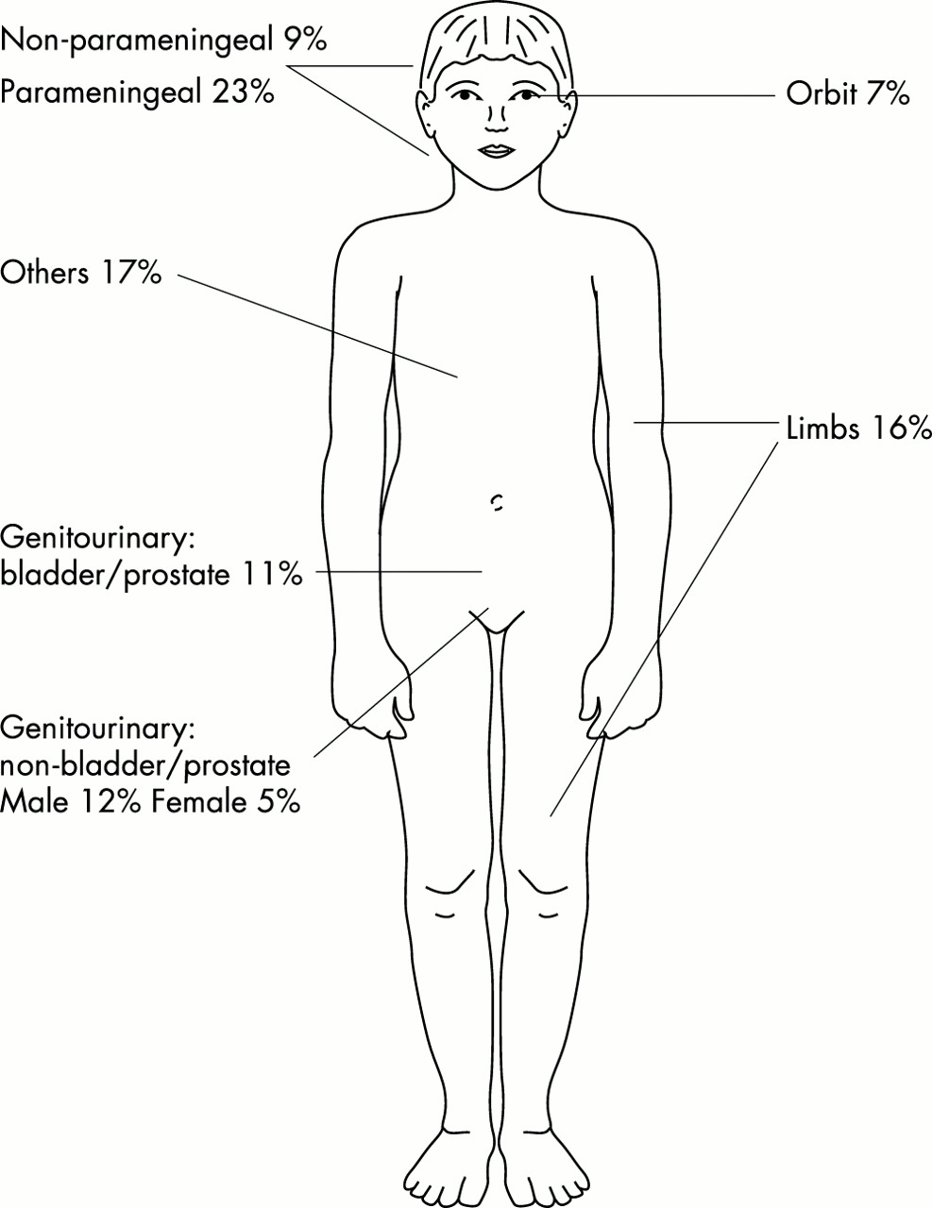
Rhabdomyosarcoma
Sites of disease
Head & Neck
Orbit
Parameningeal
Non-Parameningeal
Genitourinary
Bladder
Prostate
Para-testicular
Vagina/uterus
Extremity
Others

Slide 11
RMS – Clinical Presentation is Site Dependent
Orbit - Proptosis, ophthalmoplegia
Other head and neck/parameningeal – nasal or aural obstruction, cranial nerve palsies
Genitourinary tract – Bladder: Hematuria, urinary obstruction
Paratesticular – painless scrotal mass
Vaginal – Vaginal mass, discharge
Extremities – Swelling, pain, lymph node involvement

Slide 12
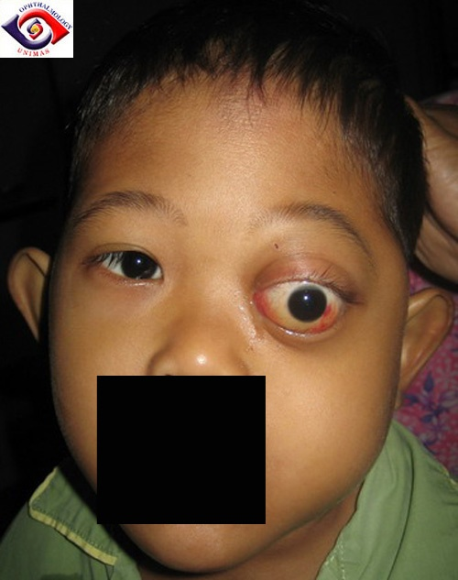
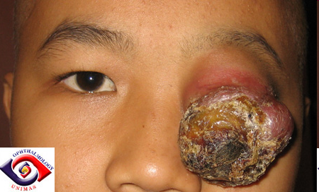
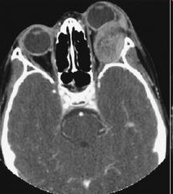
Orbital rhabdomyosarcoma

Slide 13
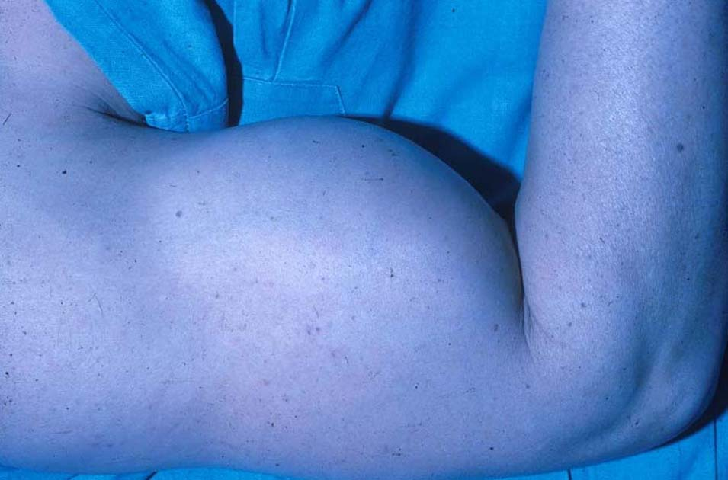
Extremity RMS

Slide 14
Rhabdomyosarcoma – Approach to Diagnosis and Staging
Evaluation of primary site – XR, CT, MRI
Biopsy / surgery
Metastatic workup – CT chest, bone scan, bone marrow, PET

Slide 15
Rhabdomyosarcoma - Pathology
Two major histologic subtypes:
I. Embryonal RMS
(Botryoid and spindle cell variants)
II. Alveolar RMS
Undifferentiated sarcoma

Slide 16
Small round blue cell tumors
Lymphoma
Neuroblastoma
Rhabdomyosarcoma
Ewing/PNET
Desmoplastic small round cell tumor (DSCRT)
Poorly differentiated synovial sarcoma
Small cell osteosarcoma

Slide 17
Small round blue cell tumors Immunohistochemistry
Tumor | Immunohistochemical markers
Ewing / ESFT | PAS+ (Glycogen); NSE (Neuron specific enolase); CD99; Fli1
Rhabdomyosarcoma | Desmin, myosin, MyoD
Lymphoma | LCA=Leukocyte common antigen=CD45 specific markers CD30-HD,ALCL; CD20-B cell; CD3-T cell; TdT
Neuroblastoma | NSE; S100

Slide 18
Staging
A process that defines the local and distant (metastatic) extent of a tumor
Tumors have unique and consistent patterns of spread
Wilms’ tumor to lungs and liver (not to bone or bone marrow)
Neuroblastoma – bones, bone marrow, lymph, (not to lungs)
Stage is associated with prognosis (metastatic disease is rarely curable)

Slide 19
Rhabdomyosarcoma - Treatment
Local control – Surgery vs. Radiation
Systemic therapy – Chemotherapy
Pediatric sarcomas are systemic illnesses

Slide 20
Pediatric Cancer as a Systemic Illness – The rule and the exceptions
THE RULE- Pediatric solid tumors are always systemic – micrometastatic disease is present at diagnosis in the majority of patients
All patients – including those with apparently localized disease - must be treated with chemotherapy
Osteosarcoma, Ewing, RMS

Slide 21
MALIGNANT BONE TUMORS
OSTEOSARCOMA
EWINGS SARCOMA

Slide 22
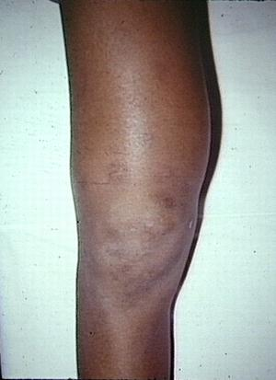
Clinical Presentation
Extremity bone pain
Progressive swelling
Distal Femur
Proximal tibia
Proximal humerus
Fever uncommon
(vs. Ewing sarcoma)

Slide 23
Diagnostic work-up
Diagnostic imaging
XR extremity (MRI)
XR chest (CT)
Laboratory
CBC
Chemistries (AP, LDH)
Biopsy
Needle vs. open
Site of biopsy important if LSP planned

Slide 24
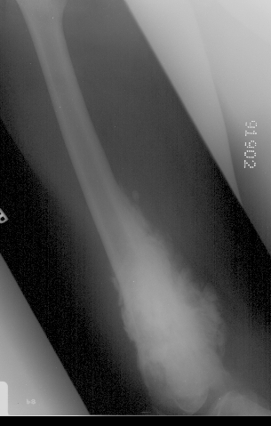
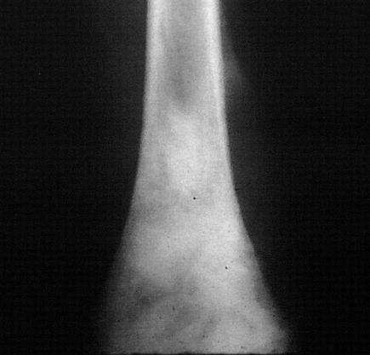

Slide 25
Bone Tumors in Children

Slide 26
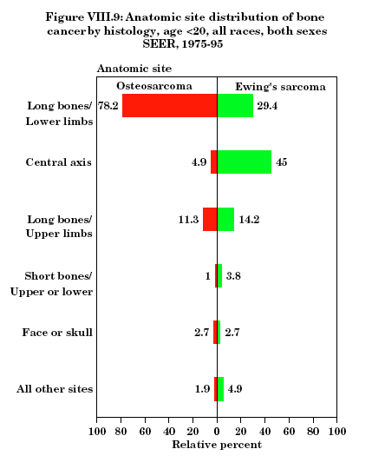

Slide 27
Bone Tumors Treatment
OSTEOSARCOMA
Systemic Chemotherapy:
Adriamycin
Cisplatin/Carboplatin
Methotrexate
Ifosfamide
Local Control:
Surgery
NO radiation therapy
EWING’S SARCOMA
Systemic Chemotherapy:
Adriamycin
Ifosfamide, cyclophos.
Etoposide
Vincristine
Local Control:
Surgery
Radiation therapy

Slide 28
Neuroblastoma
Malignant embryonic tumor of precursor cells of sympathetic ganglia and adrenal medulla
The most common malignancy in infants and extracranial solid tumor of childhood
More than 90% are in children 5 years of age or younger
Extremely Variable Natural course of the disease

Slide 29
Local Symptoms and Classic Signs
Abdomen
Retroperitoneal mass +/-abdominal distension
Metastatic :
Intervertebral foramina: dumb-bell tumor
Lymphatic and/or hematogenous spread
mostly in bone marrow(>50% of patients), bone , liver and/or skin
rarely in brain , spinal cord, heart, lung

Slide 30
Signs and Symptoms
highly associated with neuroblastoma
- Exophthalmos
Ecchymoses (‘‘raccoon eyes’’)
Horner’s syndrome (miosis, ptosis, anhydrosis)
Massive hepatomegaly
Constipation, abdominal pain
Localized back pain, weakness of extremeties
Scoliosis, bladder dysfunction
Palpable nontender subcutaneous nodules

Slide 31
Symptoms Associated with Catecholamine Production
Paraneoplastic Syndromes
Bone marrow infiltration

Slide 32
Diagnostic Work-up
Laboratory Findings
High levels of VMA in 95%, HVA in 90%
Bone marrow Aspiration and biopsy
Conventional X-ray
Thoracic X-ray for mediastinal tumor
Abdominal X-ray: often calcifications visible in the tumor
Methylisobenzyl guanidinium (MIBG) scintigraphy
Ultrasound, computed tomography and/or magnetic resonance imaging
. Myelography

Slide 33
Microscopic Features
Electron microscopy:
neurofilaments , neural tubules ,neurosecretory granules
Immunohistochemistry:
immunoperoxidase, neuron-specific enolase (NSE)
Fluorescence testing for intracellular catecholamines
Histologically
small round-cell sarcoma
Well-differentiated form: islets with polymorphic nucleus separated by fibrillar material; sometimes cells are characteristically arranged as rosettes

Slide 34
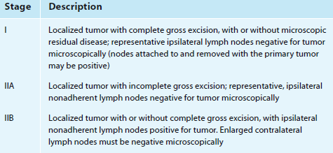
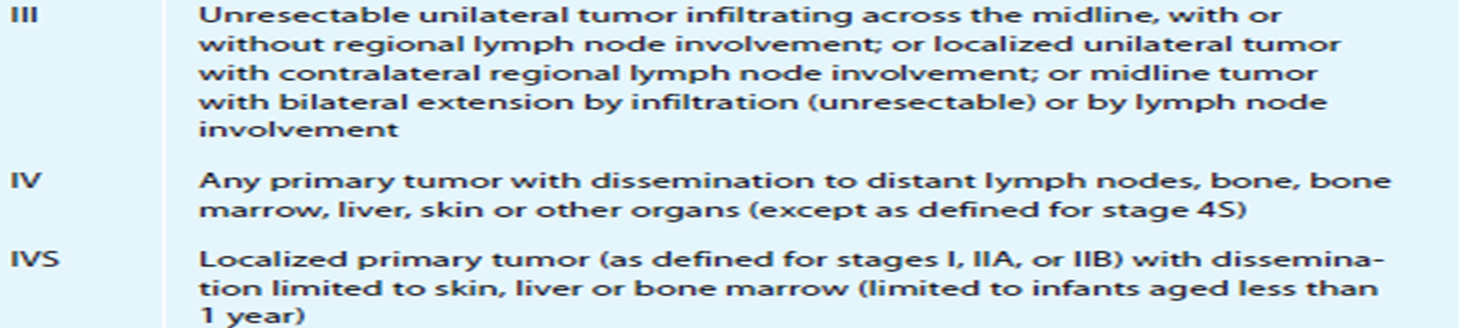
International neuroblastoma staging system

Slide 35
Therapy
Surgical procedure
Chemotherapy
Radiotherapy
Neuroblastoma is radiosensitive

Slide 36
Nephroblastoma (Wilm’s Tumor)
Malignant embryonal tumor of renal tissue
6% of all neoplasias in children
78% of children with nephroblastoma are less than 5 years old
Peak incidence between 2nd and 3rd year of age
Congenital form at delivery or during neonatal period
Rarely in adolescents and adults

Slide 37
Association
CHROMOSOMAL ASSOCIATIATION
Chromosome 11p13 with Wilms tumor suppressor gene WT1 in 10–30% of nephroblastomas
Associated with WT2 on chromosome 11p15 at a rate of 15%
CONGENITAL ANOMALIES
WAGR syndrome
Genital malformations
Denys-Drash syndrome
Beckwith-Wiedemann syndrome (BWS)
Isolated hemihypertrophy
Neurofibromatosis

Slide 38
Clinical Manifestations
Visible and palpable abdominal mass
Unclear febrile episodes, anorexia, vomiting
Hematuria ,Hypertension , Polycythemia
Coughing, pleural pain, and/or pleural effusion
Acquired Von Willebrand coagulopathy in about 8% of patients
Special symptoms in association with congenital anomalies

Slide 39
Microscopic features
Mostly mixed form of epithelial , blastemic and stromal cellular components
In well-differentiated forms glandular acini or glomerular structures separated by stroma elements which arrange cells in cords or nests

Slide 40
Laboratory Diagnosis
RFT
Urine analysis
Conventional abdominal radiography ,IVP
Ultrasound, computed tomography (CT) and/or magnetic resonance imaging (MRI)

Slide 41
Wilms’ tumor - Staging
 | Stage
Tumor confined to the kidney and completely resected. No penetration of renal capsule or sinus vessels. | I
Tumor extends beyond kidney but completely resected; a) penetration of renal capsule b) invasion of renal sinus c) biopsy d) local spillage during removal | II
Gross or microscopic residual (including gross spillage, positive margins, regional lymph nodes –renal hilar, para-aortic, or beyond, peritoneal implants, spillage beyond flank) | III
Metastatic disease outside abdomen (lungs, liver) | IV
Bilateral Wilms’ tumors | V

Slide 42
Therapy
Primary surgical resection or preoperative chemotherapy
Chemotherapy
Radiotherapy
Nephroblastoma is radiosensitive

Slide 43
Germ cell tumors
Primordial germ cells can develop into benign or malignant tumors in the
gonads
extragonadal (> 50%) sites
Retroperitoneum, brain, or mediastinum
includes
germinomas, embryonal carcinomas,
endodermal sinus tumors,
choriocarcinomas, and teratomas

Slide 44
GCT
represent about 3% of childhood malignancies.
Teratomas are the most common
Ultrasonography is the initial imaging modality
Laboratory tests
serum a-fetoprotein and beta-HCG hormone and LDH (elevated in dysgerminoma)
fetal isozyme of alkaline phosphatase (PLAP), which is elevated in seminomas

Slide 45
Treatment
Surgical resection is indicated if possible
Combination chemotherapy
The EFS rate is about 80%

Slide 46
Malignant liver masses
Include
Hepatoblastoma
Hepatocellular carcinoma
only 1% to 2%of childhood cancers

Slide 47
Hepatoblastoma
the most common primary malignant liver tumor
The mean age at diagnosis is 1 year
more than 80% of cases diagnosed before 3 years of age
seen in association with
Beckwith-Wiedemann syndrome
isolated hemihypertrophy
familial adenomatous polyposis
An asymptomatic abdominal mass the most common presentation
Anorexia, pain, or weight loss is seen in only 15% to 20% of children at diagnosis
Jaundice is rare
The most frequent sites of metastases are lungs or lymph nodes, and rarely bone, brain, or bone marrow.

Slide 48
Lab
Thrombocytosis is common with platelet counts as high as 1,500,000/mm3
Serum a-fetoprotein, elevated in essentially all patients with hepatoblastoma
U/S- the best initial imaging technique
usually a large solitary mass. Vascular

Slide 49
Treatment
Surgical resection
Chemotherapy

Slide 50
Retinoblastoma
Malignant, congenital tumor of the retina of the eye
Two percent of all neoplasias in childhood
Median age at diagnosis: 2 years
Bilateral involvement in 20–30% of cases
Hereditary and acquired forms

Slide 51
DIAGNOSIS
Leukokoria (“cat’s eye” reflex),Strabismus ,Anisocoria ,Loss of vision
Fundoscopy :tumor mostly present
Ultrasound, computed tomography (CT) or magnetic resonance imaging (MRI)

Slide 52
Treatment
Chemotherapy
Surery:Enucleation
Retinoblastoma is highly radiosensitive

Slide 53
BRAIN TUMORS
25-30% of cancer deaths
Source of major morbidity
Classified as:
Primary
Secondary

Slide 54
Brain tumors
Neuronal/embryonal non-neuronal other
brain
________________________________________
PNET Glioma Pituitary adenomas
-Medulloblastoma -Astrocytoma Craniopharyngioma
-Oligodendroglioma Germ cell tumors
-pineoblastoma -Mixed glial Hemangioma
Ependymoma
-Supratentorial PNET Choroid plexus tumors
ATRT Meningioma

Slide 55
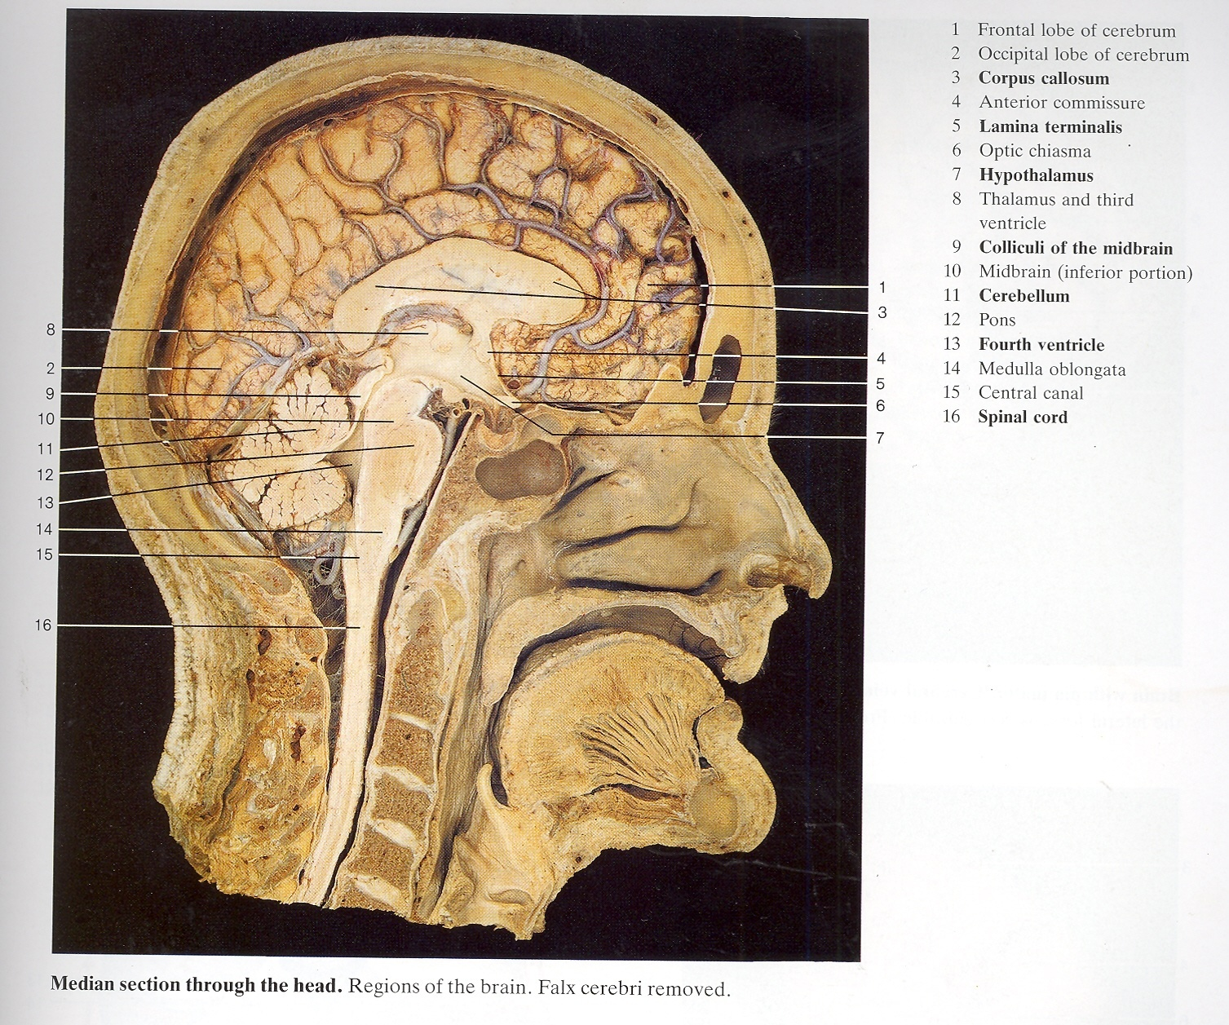

Slide 56
Infratentorial tumors
Medulloblastoma 20%
Cerebellar astrocytoma 15%
IVth ventricular ependymoma 10%
Brain stem glioma 10%
Other - astrocytoma, 4th ventricular choroid plexus tumors

Slide 57
S +S Infratentorial tumors
IVth ventricle
early intracranial hypertension
Cerebellum and cerebellar vermis
ataxia, tremor, past pointing , nystagmus , dysarthria
Brain stem
-cranial nerve palsy
-long tracts --motor, sensory
-conjugate eye movement

Slide 58
Suprasellar tumors
Optic chiasm gliomas (low grade) NF1
Thalamic and hypothalamic gliomas
(more low grade)
Craniopharyngioma
Germinoma and mixed germ cell
Pituitary adenomas
Arising from sella --Ewings,osteosarcoma. lymphoma

Slide 59
S+ S Suprasellar tumors
optic pathway
--visual loss, visual field loss -hemianopia
Hypothalamus
--temperature regulation
--satiety ( appetite) morbid obesity
--mood swings ,
Thalamus and 3rd ventricle
-long tract signs , ⬆ ICP
Anterior and post pituitary
-- diabetes insipidus, growth, thyroid, precocious or delayed puberty

Slide 60
Brain tumor therapy
Surgery
Chemotherapy
Radiation therapy

Slide 61
THE END
Thank you!

